Slide 1
Chapter 1
Professor Jamie Kraft

Slide 2

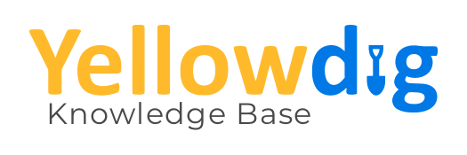
Announcements

Slide 3
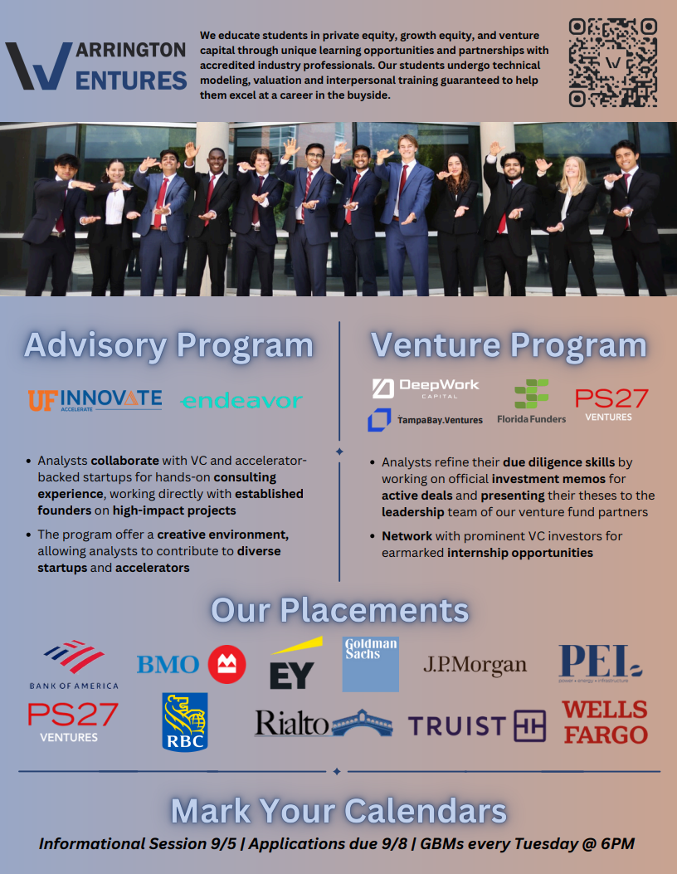
Announcements cntd.

Slide 4


Announcements cntd.

Slide 5

Definitions
Entrepreneurship: a way of thinking, acting and being that combines the ability to find or create new opportunities with the courage to act on them.
Entrepreneur—someone who begins a startup/creates a business based on validity of an idea/business model.
Startup: temporary organization in search of a scalable business model.
Neck et al., Entrepreneurship, 3e. © 2025 Sage Publishing.

Slide 6
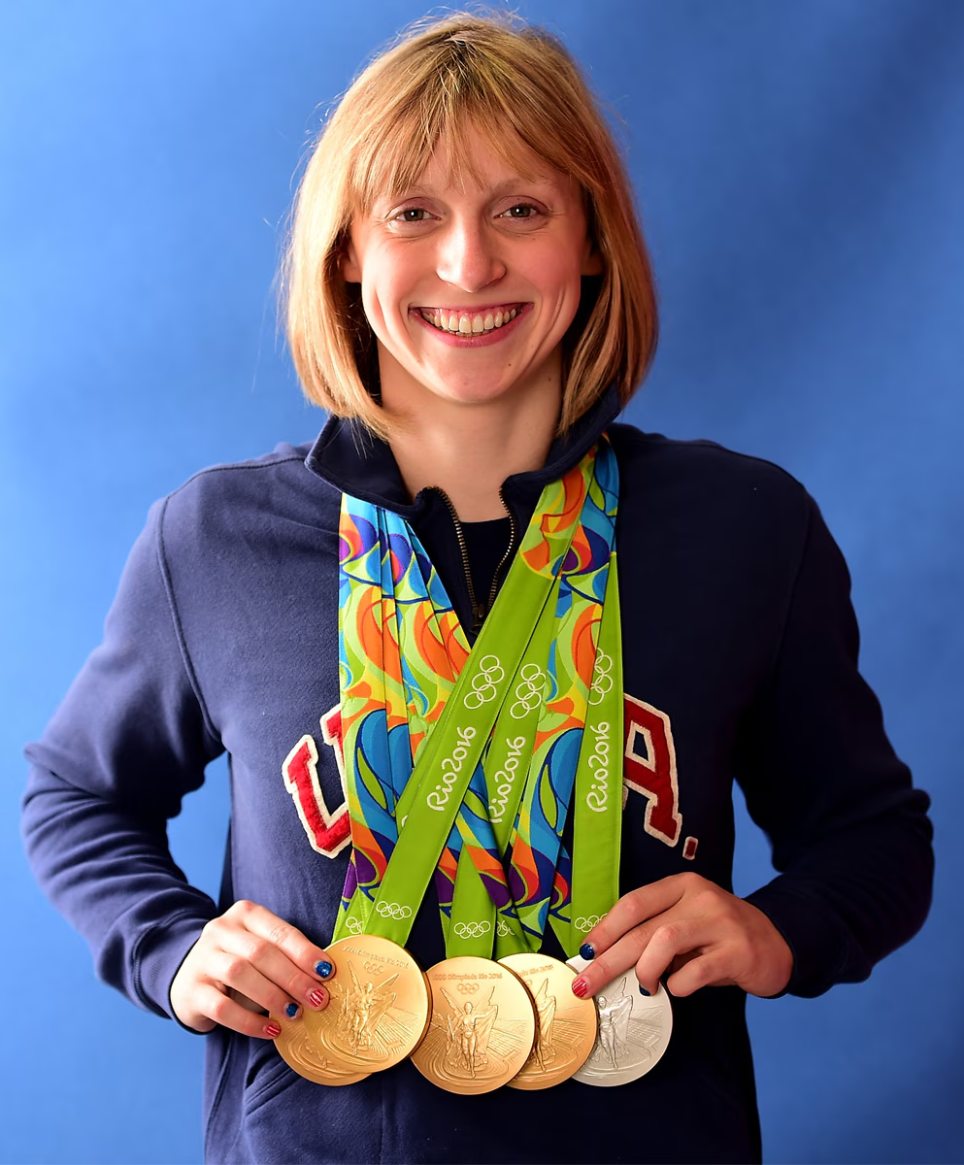
Features of Entrepreneurship
1) Method that requires practice.
Process view of entrepreneurship—starting something new is a linear, predictable process. Entrepreneurship is not predictable.
Method view of entrepreneurship—skillsets with an entrepreneurial mindset constitute a toolkit for action.
Neck et al., Entrepreneurship, 3e. © 2025 Sage Publishing.

Slide 7
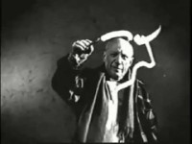
Features of Entrepreneurship cntd.
2) Entrepreneurs think differently.
Effectuation: how entrepreneurs think to start new ventures; future is unpredictable yet controllable through human action.
Taking action/ collect information/ reduce risk/ leverage resources
Neck et al., Entrepreneurship, 3e. © 2025 Sage Publishing.

Slide 8
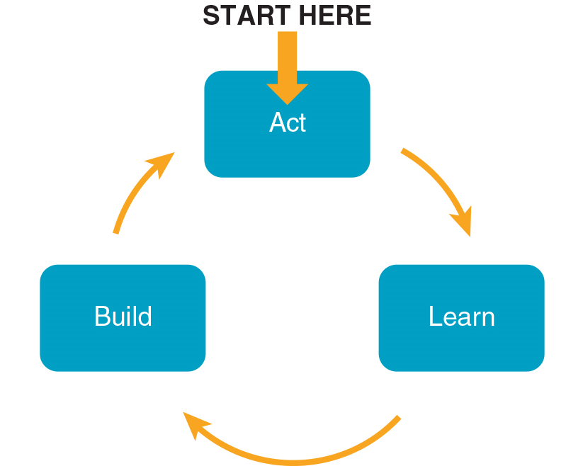
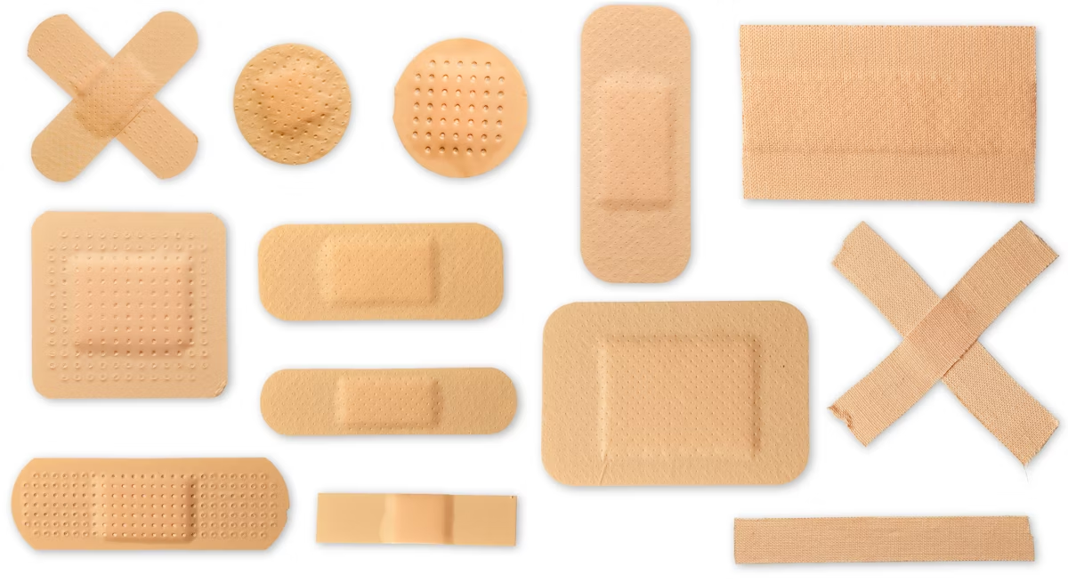

Features of Entrepreneurship cntd.
3) Entrepreneurs act more than plan.
Evidence-based entrepreneurship: Planning that aligns with the scientific method of collecting data and testing ideas to validate (or not) an opportunity.
Neck et al., Entrepreneurship, 3e. © 2025 Sage Publishing.

Slide 9
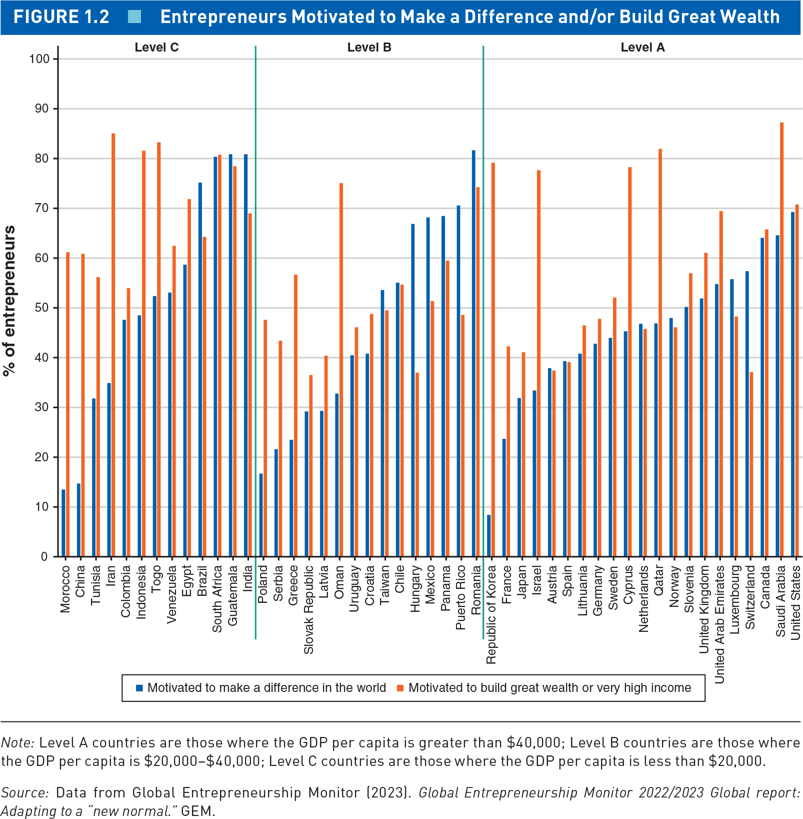
Features of Entrepreneurship cntd.
4) Profit not the only motive.
The highest performing companies do good while making money.
Americans are almost equally motivated by wealth and impact.
Neck et al., Entrepreneurship, 3e. © 2025 Sage Publishing.

Slide 10
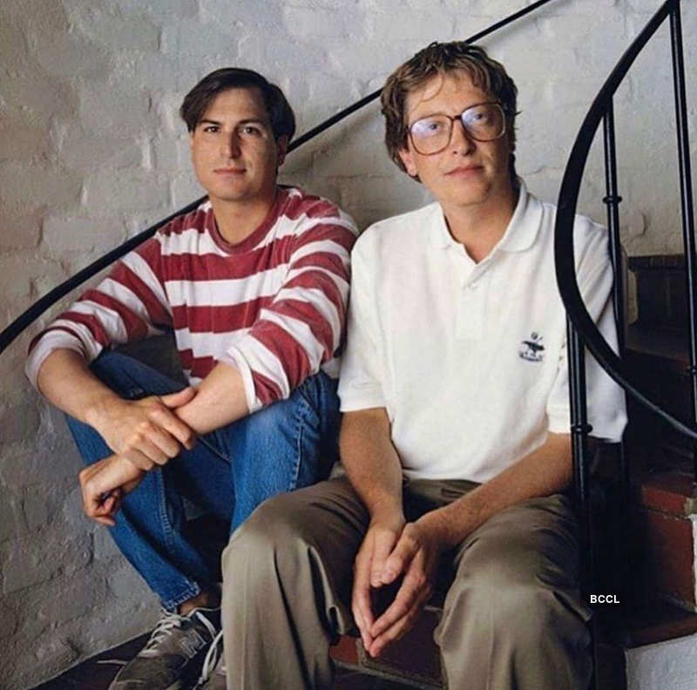
Features of Entrepreneurship cntd.
5) Entrepreneurs collaborate more than compete.
Building strong connections with others is key to business success.
Information, financing, emotional support, expertise, learning and information exchange.
Can reduce loneliness.
Neck et al., Entrepreneurship, 3e. © 2025 Sage Publishing.

Slide 11
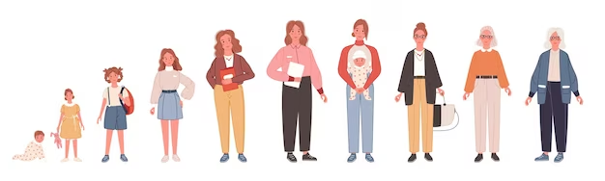
Features of Entrepreneurship cntd.
6) Entrepreneurship is a life skill.
Thinking and acting more entrepreneurially helps one get comfortable with uncertainty, accept change, and look at the world through a solution-driven, opportunity lens.
Neck et al., Entrepreneurship, 3e. © 2025 Sage Publishing.

Slide 12

Ways to Access Entrepreneurship
1) Corporate Entrepreneurship
Employees create new products, ventures, or processes within large corporations.
Identify opportunities.
Build teams.
Create something of value.
Neck et al., Entrepreneurship, 3e. © 2025 Sage Publishing.

Slide 13
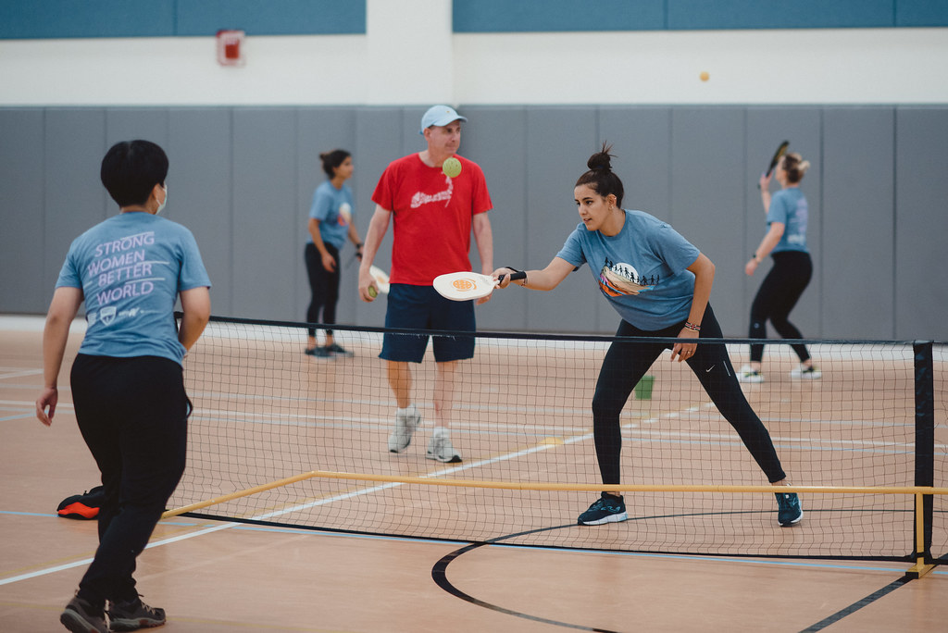
Ways to Access Entre. cntd.
2) Entrepreneurship Inside
Intrapreneurs are employees who think and act entrepreneurially within any type of organizations.
Embrace experimentation. Have the capacity/desire to change organizations from within.
Neck et al., Entrepreneurship, 3e. © 2025 Sage Publishing.

Slide 14
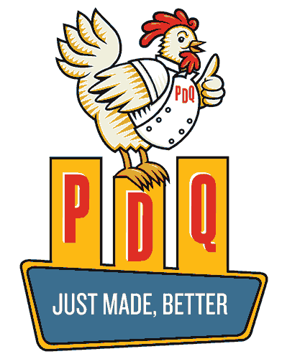
Ways to Access Entre. cntd.
3) Franchising
A method of distributing products or services involving a franchisor (the creator of the brand name and business operating system) and franchisee (the operator that buys the license to do business using the company name and operating system).
Neck et al., Entrepreneurship, 3e. © 2025 Sage Publishing.

Slide 15
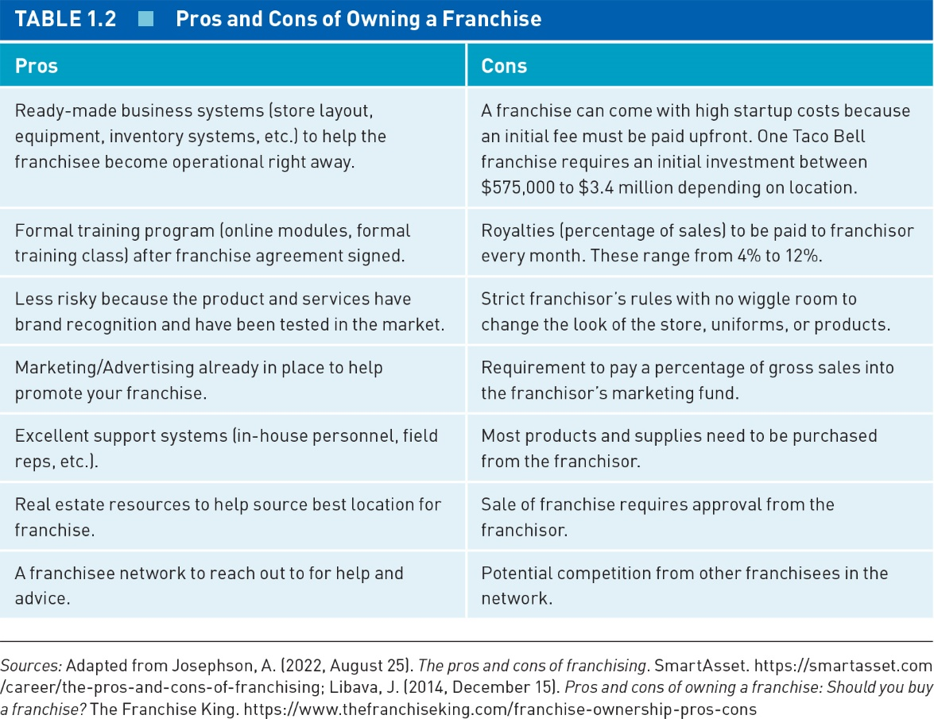
Ways to Access Entre. cntd.
3) Franchising cntd.
Neck et al., Entrepreneurship, 3e. © 2025 Sage Publishing.

Slide 16

Ways to Access Entre. cntd.
4) Buying a Small Business
Entrepreneur buys out the existing owner and takes over operations.
Thousands of businesses are for sale, but only 30–40% actually sell.
Neck et al., Entrepreneurship, 3e. © 2025 Sage Publishing.

Slide 17
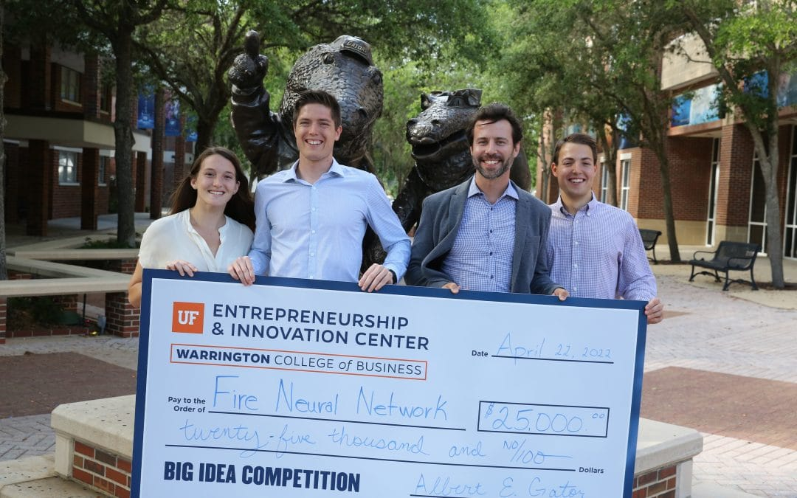
Ways to Access Entre. cntd.
5) Social Entrepreneurship
Sourcing solutions to social and environmental problems (SDGs).
Benefit corporation (B Corp): Certified by B Lab…ensures strict standards of social/ environmental performance, accountability, and transparency.
Neck et al., Entrepreneurship, 3e. © 2025 Sage Publishing.

Slide 18
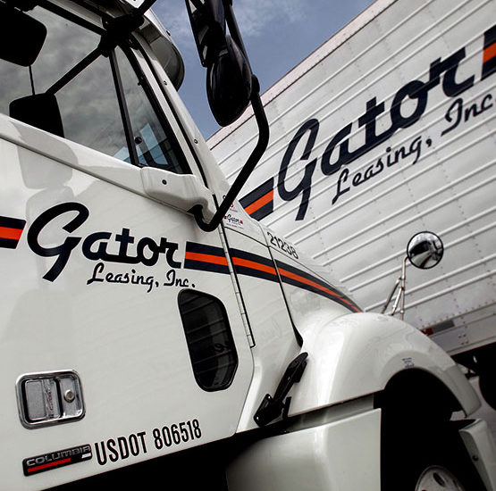
Ways to Access Entre. cntd.
6) Family Enterprising
A business that is owned and managed by one or more family members beyond the founding generation.
Each generation has an opportunity to bring the organization forward.
Neck et al., Entrepreneurship, 3e. © 2025 Sage Publishing.

Slide 19

Ways to Access Entre. cntd.
7) Serial Entrepreneurship
People who start several businesses, whether simultaneously or one after another.
Constantly look out for the next big thing/explore ways to implement diverse ideas.
Neck et al., Entrepreneurship, 3e. © 2025 Sage Publishing.

Slide 20
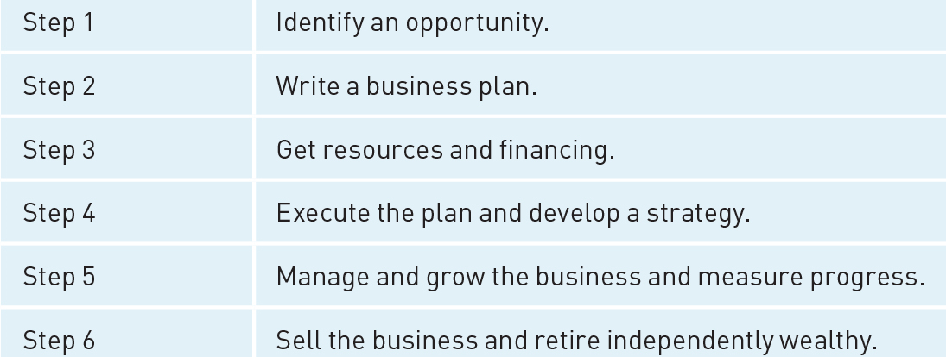
Entrepreneurship as a Method
Traditionally, entrepreneurship has been viewed as a process of sequential steps that lead to a successful business.
However, entrepreneurship is nonlinear, unpredictable, ill-defined, unstructured, and complex.
Neck et al., Entrepreneurship, 3e. © 2025 Sage Publishing.

Slide 21
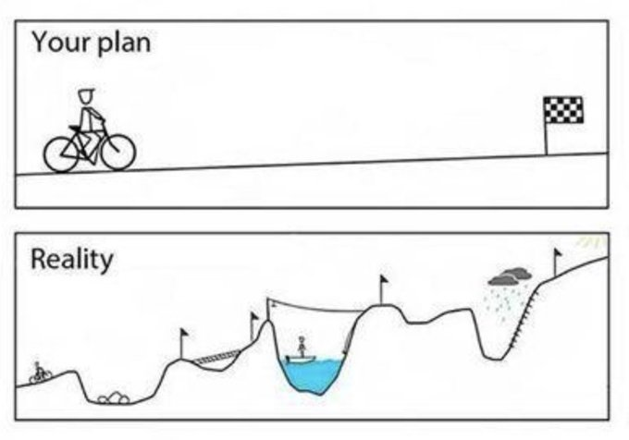
Entrepreneurship as a Method cntd.
Entrepreneurship as Method:
Approach to doing something with no guarantee of a particular outcome.
Can guide you through chaos and increase chances of success.
Gets easier and more useful with practice.
Neck et al., Entrepreneurship, 3e. © 2025 Sage Publishing.

Slide 22
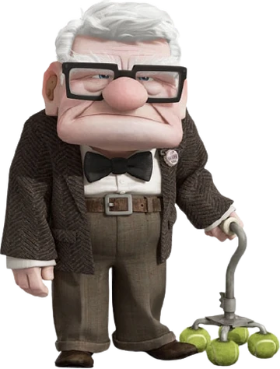
Entrepreneurship as a Method cntd.
Managerial Versus Entrepreneurial Thinking
Entrepreneurial ventures are not smaller versions of large corporations.
More uncertainty and risk and a lot less information and data in entrepreneurship.
Neck et al., Entrepreneurship, 3e. © 2025 Sage Publishing.

Slide 23
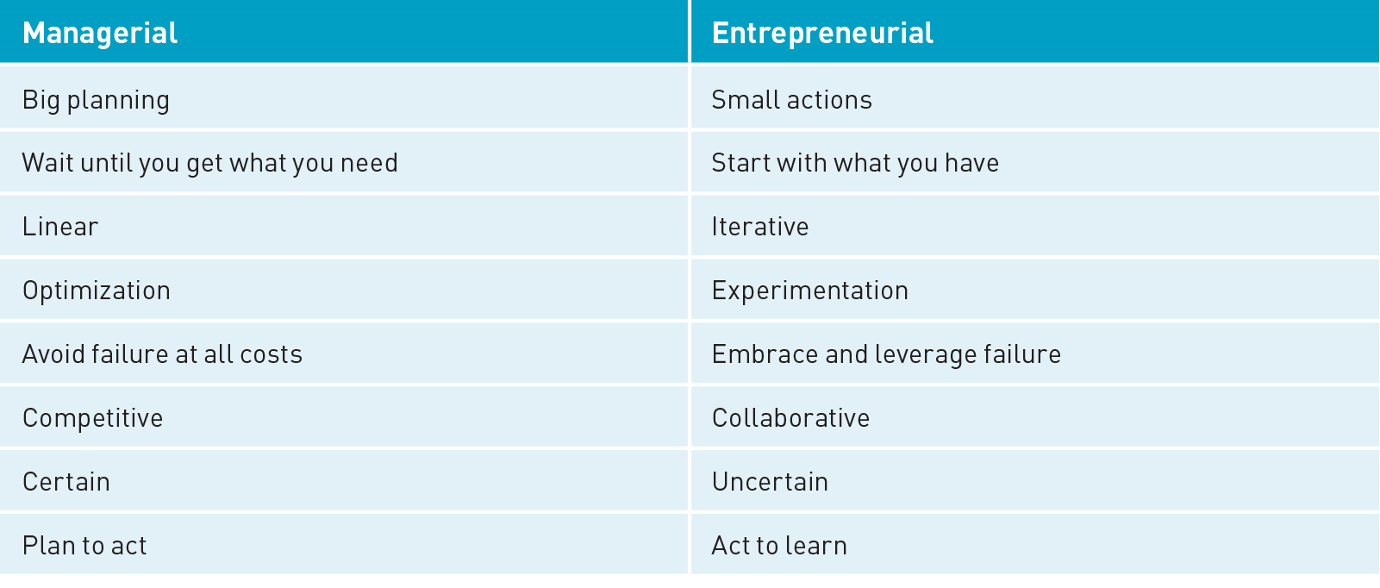
Entrepreneurship as a Method cntd.
Neck et al., Entrepreneurship, 3e. © 2025 Sage Publishing.

Slide 24
Key Components
The Entrepreneurship Method:
Method of entrepreneurship in the text is based on Babson’s Entrepreneurial Thought & Action® (ET&A), which is grounded in effectuation theory.
Smart action over planning.
Moving quickly from whiteboard to real world.
Can be learned, repeated, and practiced.
Neck et al., Entrepreneurship, 3e. © 2025 Sage Publishing.

Slide 25
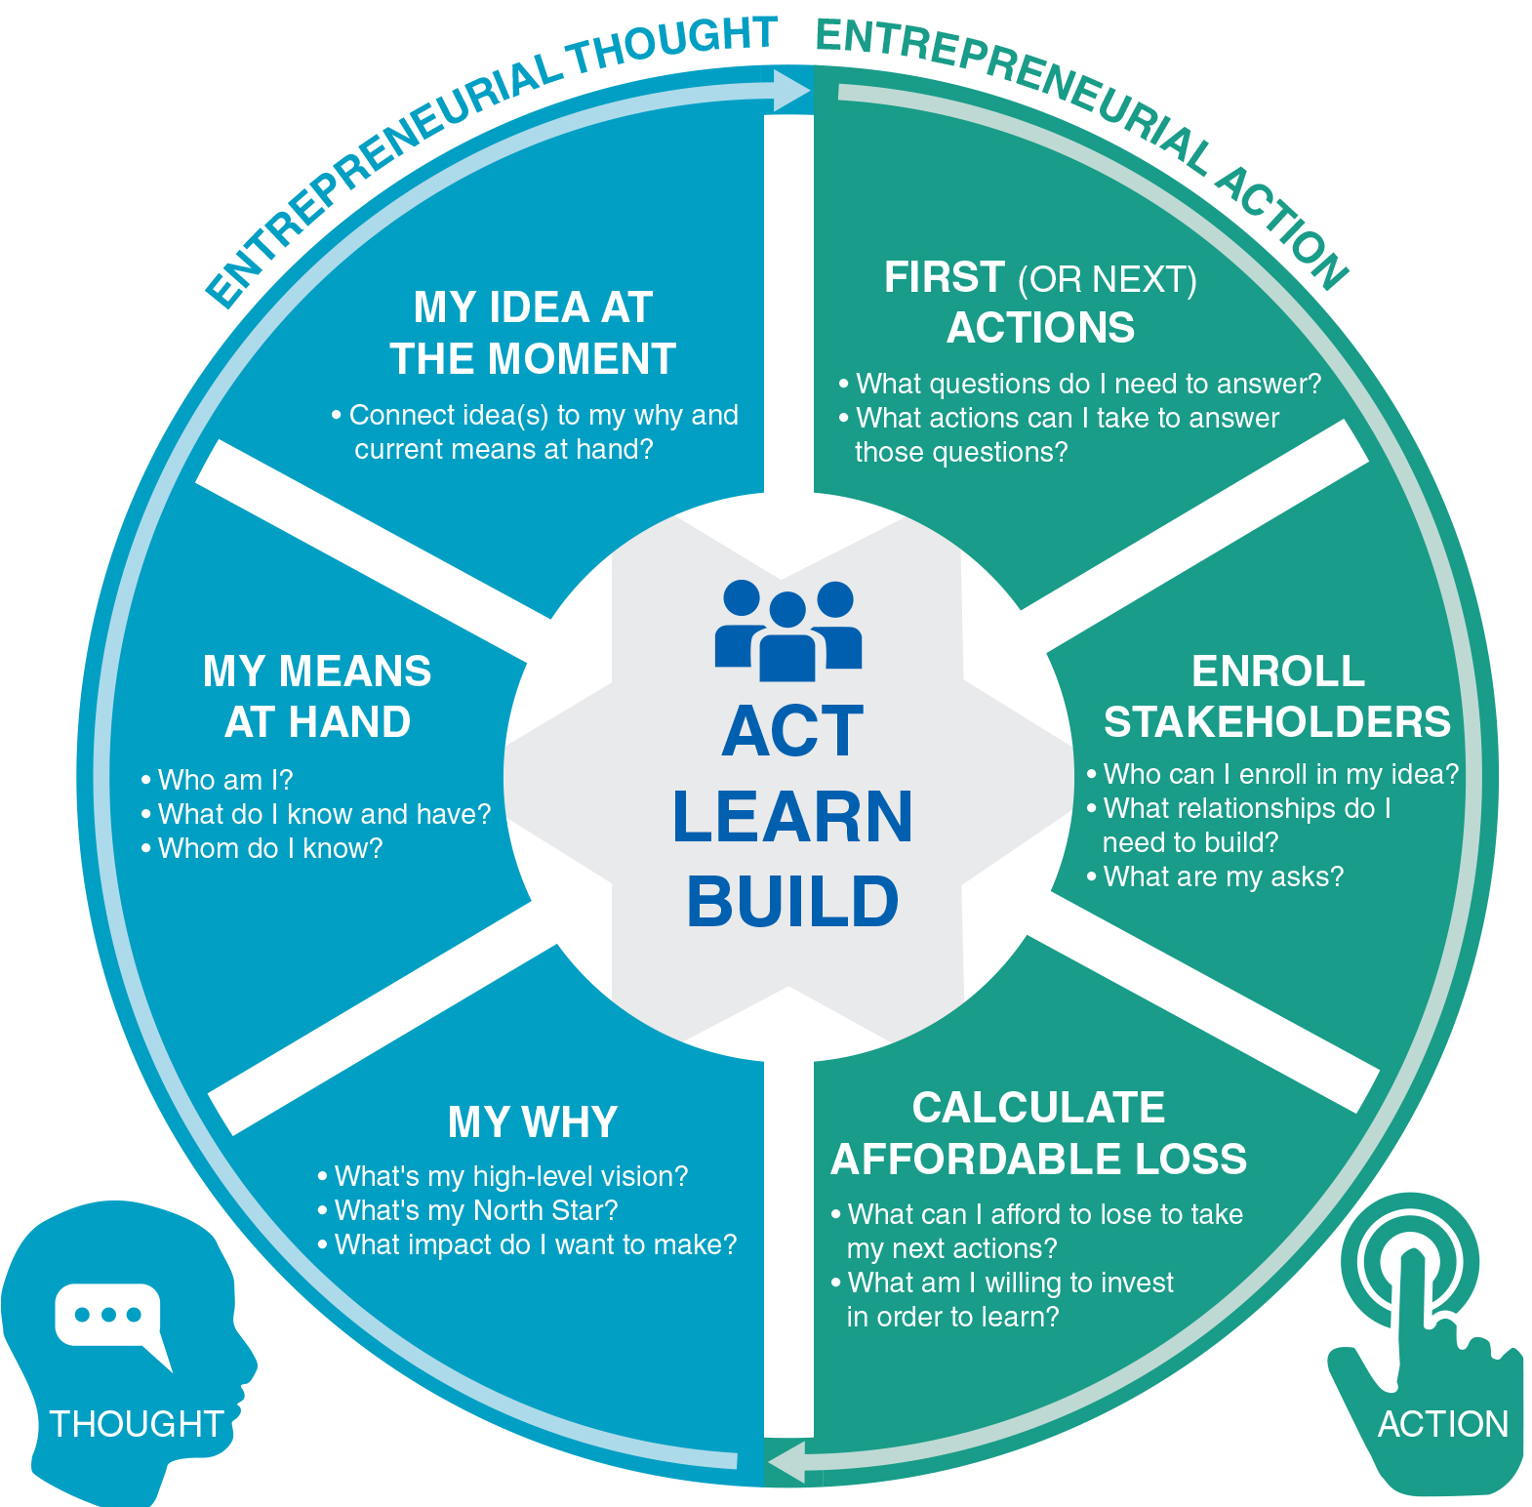
Key Components cntd.
Seven Components of the Entrepreneurship Model
You will act sooner.
You will try.
You will try more times.
You will fail sooner.
You will experiment simultaneously.
Ideas that gain traction will likely be deeply connected to who you are.
Neck et al., Entrepreneurship, 3e. © 2025 Sage Publishing.

Slide 26

Role of Deliberate Practice
The process where high performers carry out focused efforts to improve performance.
When brain cells sense focused repeated activity, myelin is created, this increases speed and strength of neural impulses and improves performance.
Regular practice without focused effort, consistent feedback, and guidance only reinforces mindless, automatic habits.
Neck et al., Entrepreneurship, 3e. © 2025 Sage Publishing.

Slide 27
Siete Foods Case DISCUSSION

Slide 28

Case: Siete Foods

Slide 29

Summary
Objectives
Founded in 2014 by “seven” members of the Garza family
Produce grain-free/gluten-free/dairy-free Mexican snacks
As of 2022:
100 employees/ 60 unique products
More than 16,000 retail locations (Wal-Mart, Whole Foods, Target, Kroger, etc.)

Slide 30

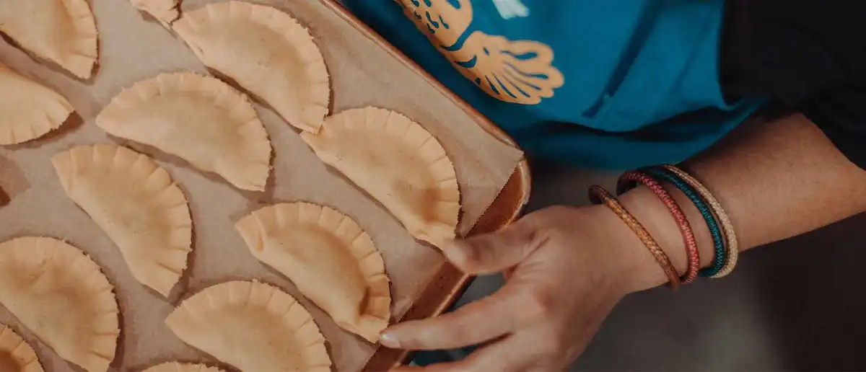
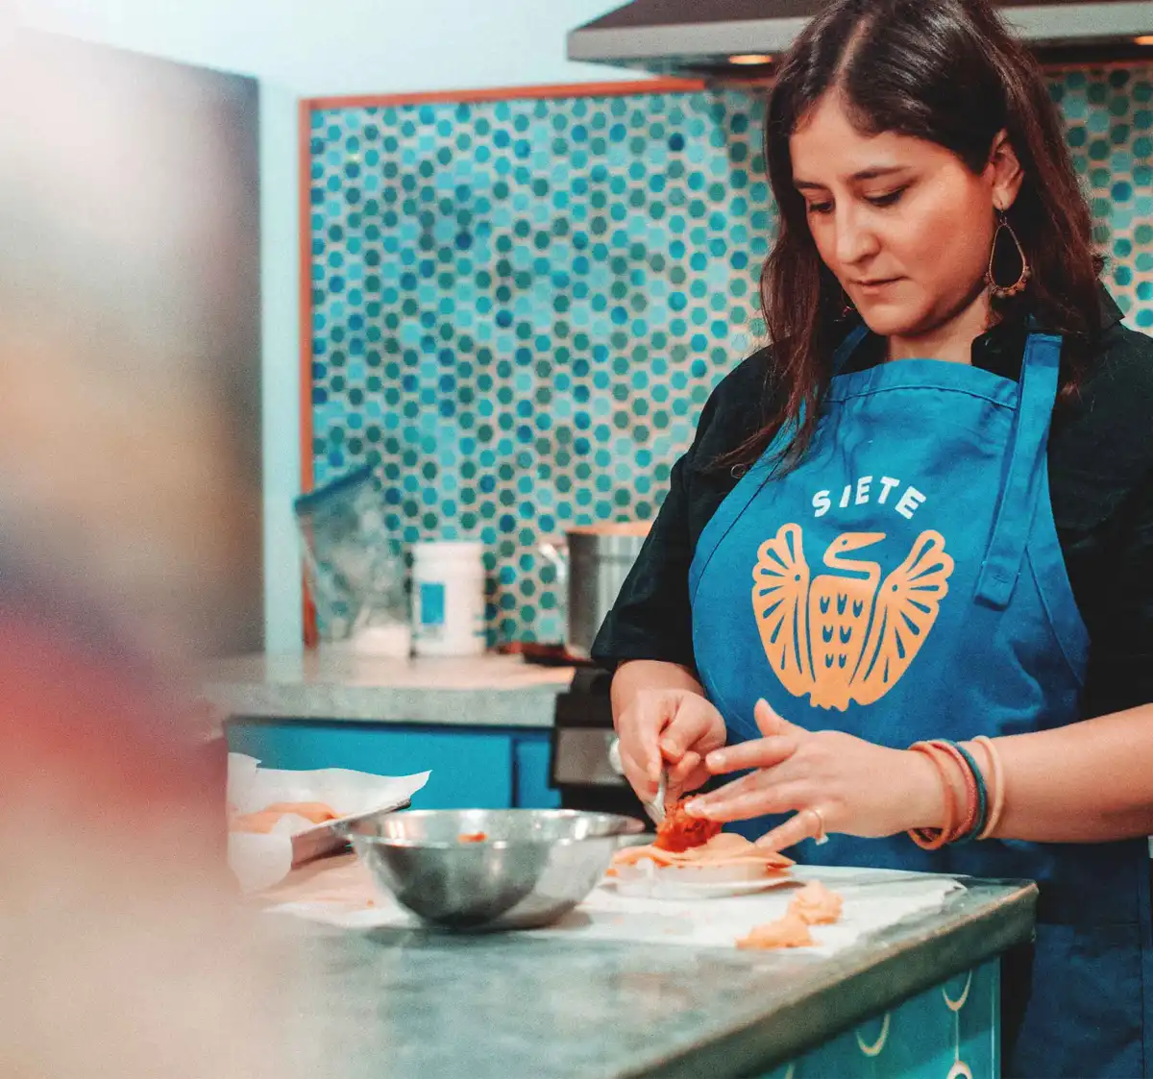
Problem
Objectives
Veronica diagnosed with multiple autoimmune conditions
She adopts “paleo” diet (low-inflammation/ grain-free)
Opens a CrossFit-affiliated gym (investment from parents)…marginal profitable
Problem: Lack of grain-free versions of culturally familiar foods (Mexican American). So Veronica begins testing. (dinner party samples and selling to gym-goers/friends)

Slide 31
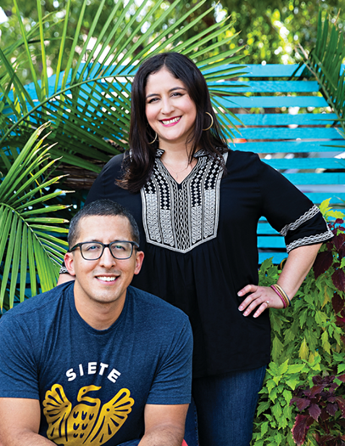
Solution
Objectives
Solution: “Must B Nutty” Tortillas (then many other snack items under “Siete” name) launched in Austin, TX
On-board a grocery cooperative, get into a local Austin-based Wholefoods and join SKU accelerator
Raise $1 million from angel investors
In 2019 Siete raised $90 million (Stripes and AF Ventures)

Slide 32
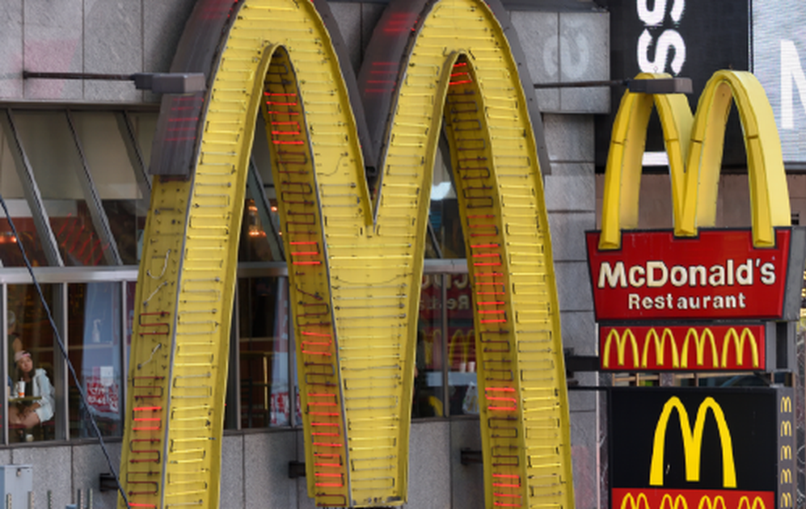

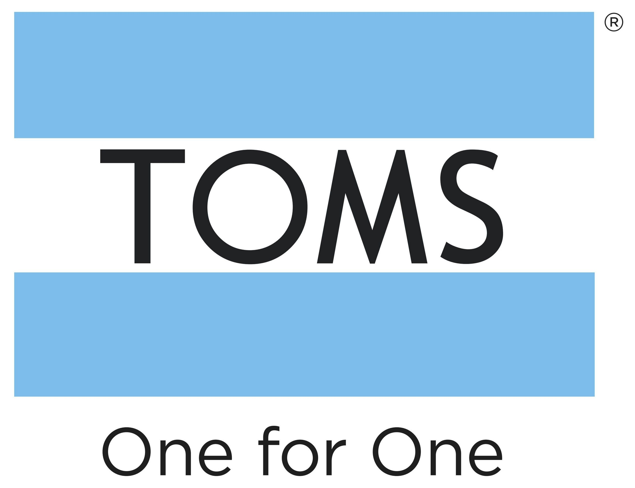

Types of Entrepreneurship
Corporate Entrepreneurship
Entrepreneurship Inside
Buying a Small Business
Franchising
Social Entrepreneurship
Family Business
Serial Entrepreneurship

Slide 33
Critical Thinking Questions
Which of the six features of modern entrepreneurship can you identify in the Garza’s story?
The Entrepreneurship Method is about taking action under conditions of uncertainty. Do you see evidence of the Method during the creation of Siete Family Foods?
As you think about doing something entrepreneurial, today or someday, what is your motivation for doing so?

Slide 34
Critical Thinking Questions
Which of the six features of modern entrepreneurship can you identify in the Garza’s story?
The Entrepreneurship Method is about taking action under conditions of uncertainty. Do you see evidence of the Method during the creation of Siete Family Foods?
As you think about doing something entrepreneurial, today or someday, what is your motivation for doing so?

Slide 35
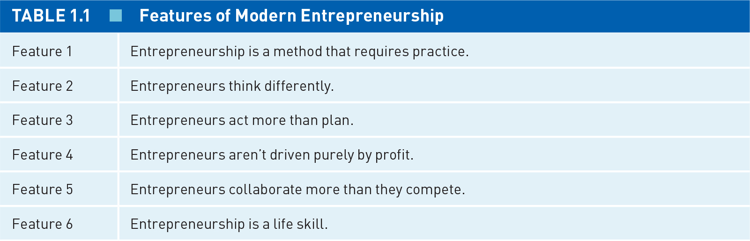
Features?

Slide 36
Critical Thinking Questions
Which of the six features of modern entrepreneurship can you identify in the Garza’s story?
The Entrepreneurship Method is about taking action under conditions of uncertainty. Do you see evidence of the Method during the creation of Siete Family Foods?
As you think about doing something entrepreneurial, today or someday, what is your motivation for doing so?

Slide 37
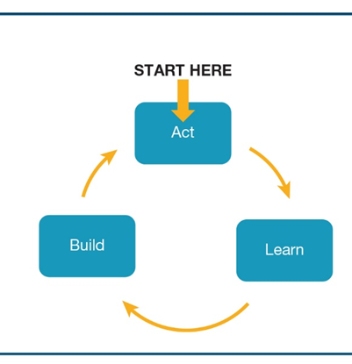
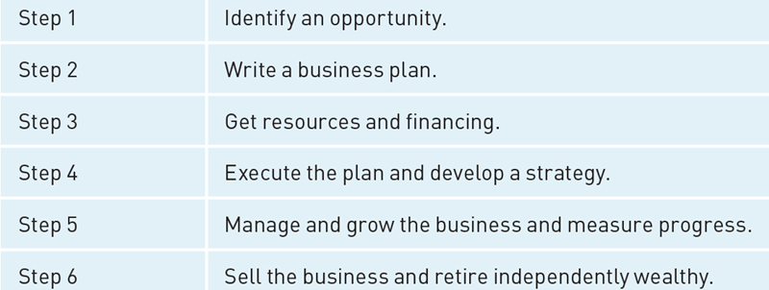
Action trumps everything!
VS.

Slide 38
Entrepreneurship Method
Begin addressing problem (CrossFit then tortillas)
Testing tortillas at party and selling to friends
On-board buyer
Connect to Whole Foods
Join SKU
Raise funding
Motivation/ MBA
Parents
Brother
Keeps her day job (health insurance) but works on the business
Commercial kitchen
Uses retirement savings
Hand then equipment
Make a difference for those suffering from food allergies

Slide 39
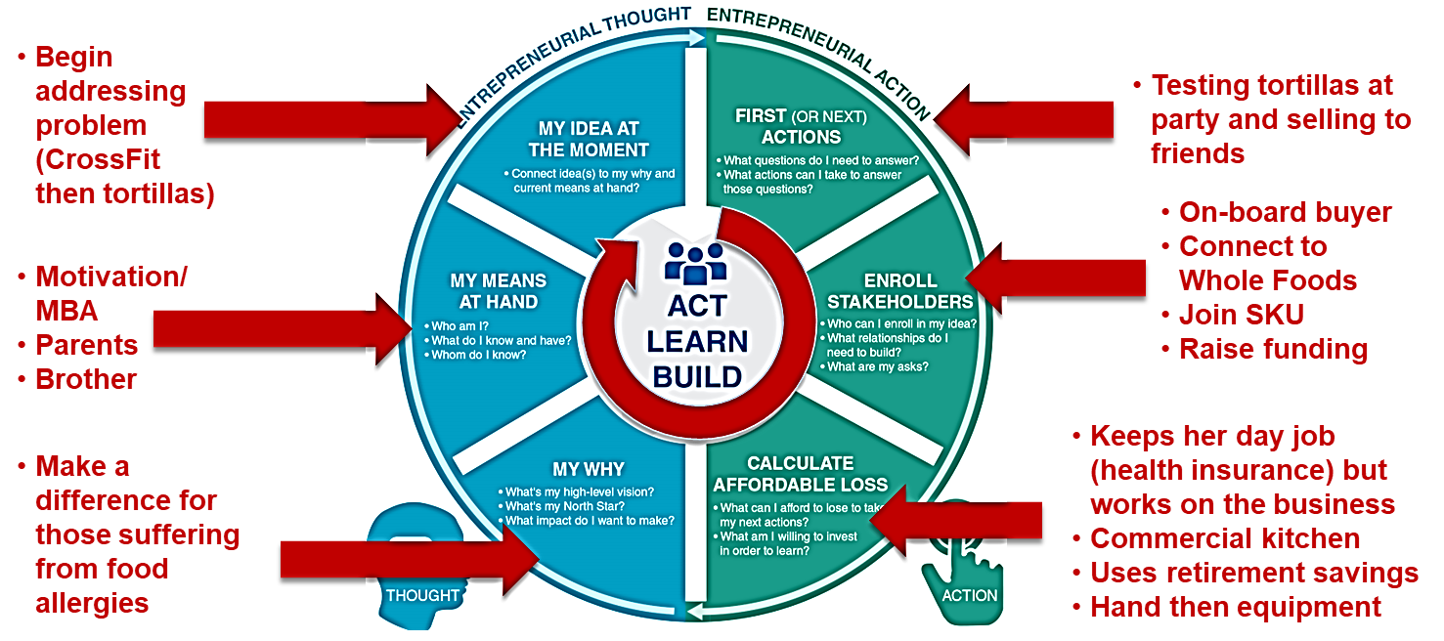
Effectuation
EFFECTUATION

Slide 40
Critical Thinking Questions
Which of the six features of modern entrepreneurship can you identify in the Garza’s story?
The Entrepreneurship Method is about taking action under conditions of uncertainty. Do you see evidence of the Method during the creation of Siete Family Foods?
As you think about doing something entrepreneurial, today or someday, what is your motivation for doing so?

Slide 41


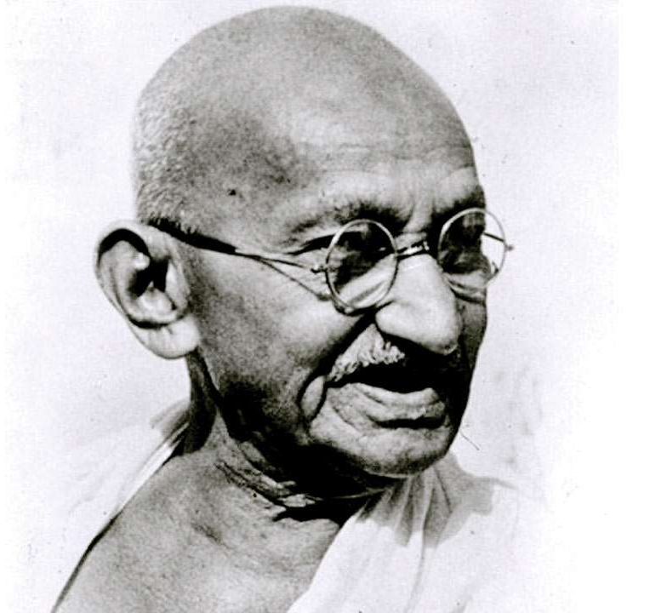

Motivation
Objectives

Slide 42
Marshmallow tower Activity

Slide 43
Learning Objectives
Objectives
Under conditions of uncertainty, entrepreneurs rely on experimentation and iterative learning.
Failing early and fast, and then pivoting can be a strategy for success

Slide 44
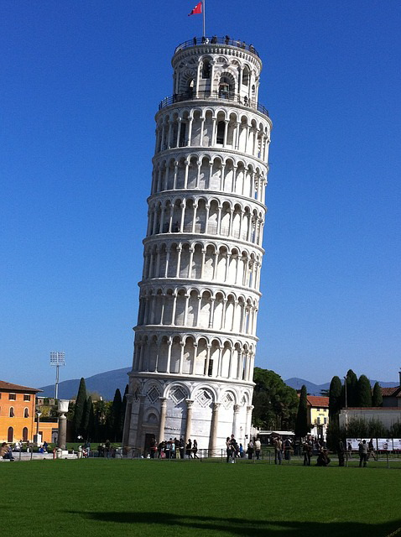
Marshmallow Tower Challenge
Objectives
Goal: Build the tallest “freestanding” structure!
(measured from the desktop surface to the top of the marshmallow…the structure cannot be suspended)
This exercise has been done by tens of thousands of people around the world from children to CEOs!

Slide 45

Rules
Objectives
The entire marshmallow must be on top of the structure (no cutting-off or eating part of the marshmallow)
Use as much or as little of the kit as you choose
20 spaghetti sticks, string and tape (you cannot use the bag or scissors in the structure!)
Break up the spaghetti, string or tape if you choose
The challenge lasts 18 minutes (you cannot be holding or be touching the structure when the time runs out!)

Slide 46

Debrief I
Objectives
What process did you use in building your structure?
What went wrong? How did you deal with that?

Slide 47

Debrief II
Objectives

Slide 48

Key Takeaways
Objectives
In an unknown environment, it is better to take action than plan
Learning from small experiments and trials can produce more unique solutions – particularly if the future cannot be predicted
Failure can provide important insights to improving products or services

